Slide 1
3D Object Reconstruction From 2D Video Frame
Members: Shivani Chaudhari Atharva Pagare Dwarkesh Haldankar | Guide: Prof. Ushma Shah

Slide 2
Objective:
To create a 3D model reconstructed from a 2D video frame.
Obtaining decent results on the predicted 3D object representation.
Rendering the 3D object according to the video.

Slide 3
Autoencoder:
Data specific
Automatic learner
Lossy
Good at image denoising

Slide 4
Libraries Used:
OpenCV (cv2)
Ker3as
Tensorflow
Numpy
Matplotlib

Slide 5
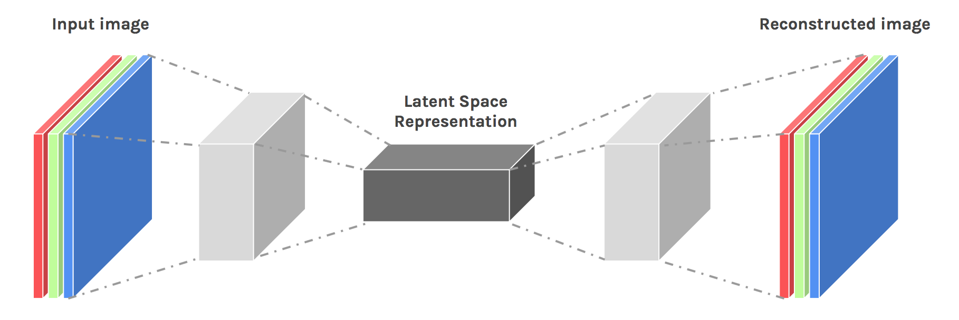
CNN Architecture

Slide 6
Challenges Faced:
Less data available
Time required to train the data is very high (therefore more epochs were required to train the large data)
Less computing power

Slide 7
Algorithm:
Pass the noisy frame through the first layer of the autoencoder after preprocessing it.
Forward propagate through the network and compute the binary cross entropy loss.
Backpropagate and find the appropriate weights for each layer.
Repeat steps 2 and 3 for all the images (single epoch) for 200 iterations.
The loss is observed to decrease after each iteration.
Finally, if tested with new images, decent results are obtained.

Slide 8
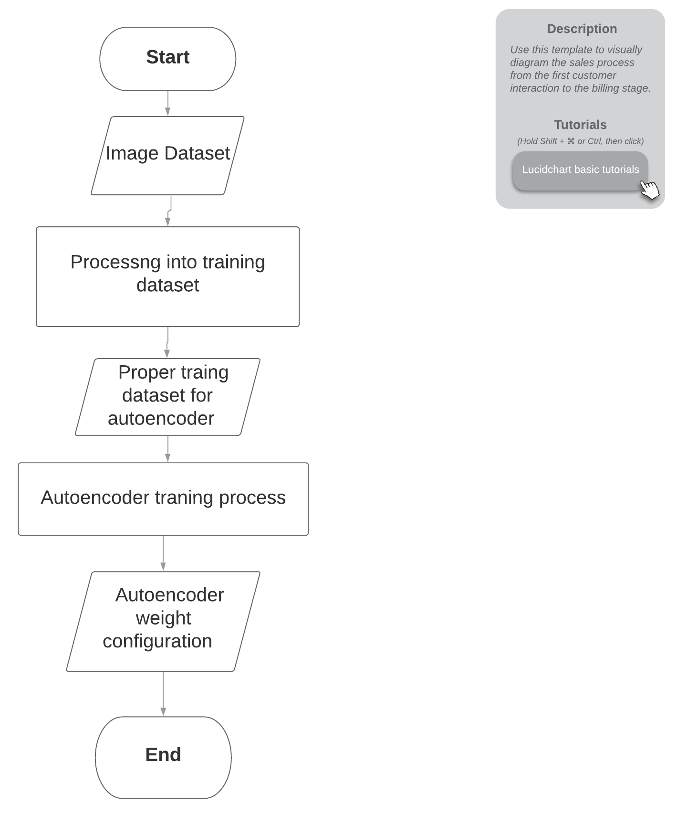

Slide 9
Work done till date:
Extracting frames of a video using Python library OpenCV.
Denoising the image using encoder decoder model (implements Convolutional Neural Networks).
Working on object detection to be reconstructed in 3D.

Slide 10
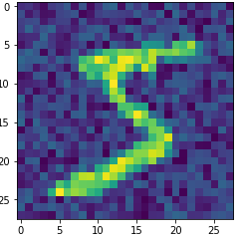


Results:
Original Image
Noisy Image
Image Obtained after denoising.

Slide 11
References:
Research Paper On 3D Object Reconstruction from 2D images: https://arxiv.org/pdf/1906.06543
Auto-Encoder: https://blog.keras.io/building-autoencoders-in-keras.html
Ian Goodfellow, Yoshua Bengio & Aaron Courville. “Deep Learning”. MIT Press 2016
Nitish Srivastava, Geoffrey Hinton, Alex Krizhevsky, Ilya Sutskever & Ruslan Salakhutdinov. “Dropout: A Simple Way to Prevent Neural Networks from Overfitting”. Journal of Machine Learning Research 2014

Slide 12
Thank You.

Slide 13
Approach
Extracting frames of a video using Python library OpenCV.
Denoising the image if necessary using encoder decoder model(implements Convolutional Neural Networks).
Implementing the model to convert the image to 3D object using Deep Learning approach.
Rendering the 3D object by using Blender software.
Notes:
Python
Open CV
Mathematical Libraries in python (scipy, numpy)
Machine Learning models( Keras, Pytorch, Tensorflow)
Rendering software.

Slide 14
Motivation
-Why Deep Convolutional Neural Networks?
Better results on a relatively large datasets.
More flexibility on tuning hyperparameters.
Works best with unstructured data (i.e Images, Audio, Text etc.)
Many pretrained models available through open source platforms.

Slide 15
Obtaining raw video footage.
Detect Object to be reconstructed in 3D.
Denoising the frame if the image is noisy.
Converting a two dimensional video to a three dimensional object frame by frame.
Smoothening the obtained 3D object

Slide 16
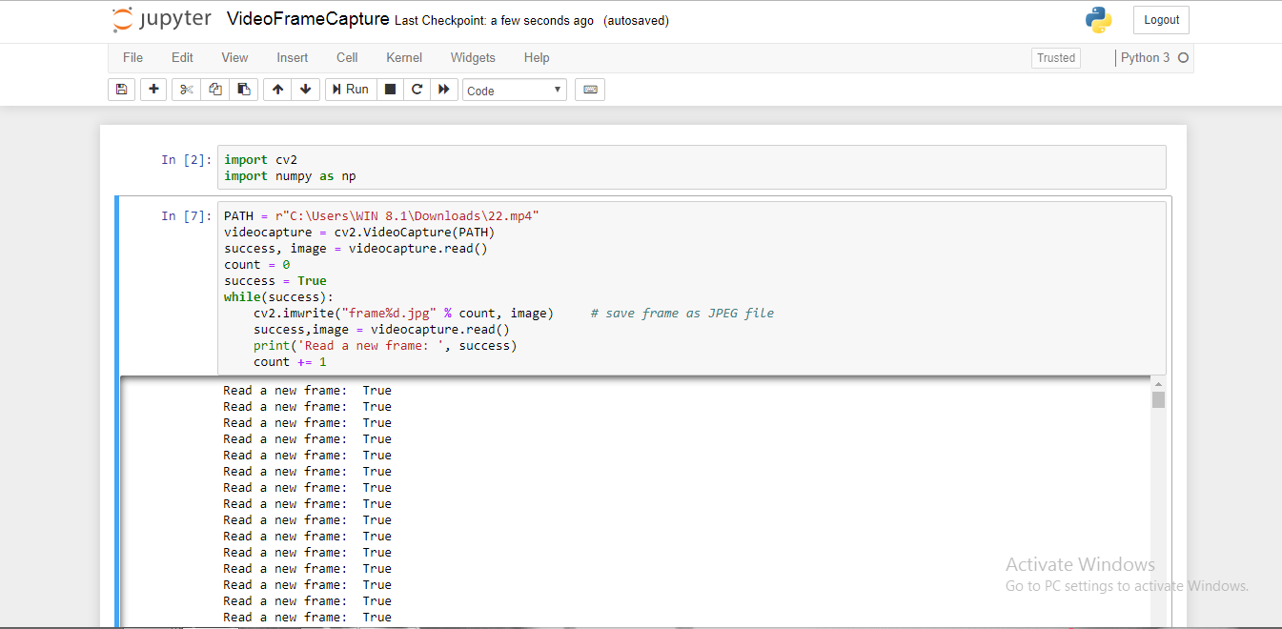

Slide 17
Plan of Action.
July 2019
August 2019
Sept 2019
Oct 2019
Jan 2020
March 2020
Project Idea
Presentation 1
Presentation 2
Extraction of frames from the video.
Denoising of the image (i.e each frame of the video).
Making CNN Model and obtaining initial results.
Refining results and rendering the 3D Model.
Final Presentation and Black Book submission.

Slide 18
References:
Research Paper On 3D Object Reconstruction from 2D images: https://arxiv.org/pdf/1906.06543
Research paper on Deep Neural Networks and backpropagation.
Auto-Encoder: https://blog.keras.io/building-autoencoders-in-keras.html
Deep Learning Blogs on Towards Data Science.
Wikipedia Article On Convolutional Neural Networks.

